Slide 1
Memory Management

Slide 2
Background
Main Memory
CPU
cache
instructions
Registers
Process
data
program image
in memory
Operating System
Disk

Slide 3
Program addresses and memory
When code is generated (or assembly program is written) we use memory addresses for variables, functions and branching/jumping.
Those addresses can be physical or logical memory addresses.
In very early systems they are just physical memory addresses.
A program has to be loaded to that address to run.
No relocation
func
variable
func
variable
func
variable
main
program

Slide 4
Program addresses and memory
RAM
physical addresses
of RAM
Assume they are physical addresses
44
40
Program
36
32
Add
12
28
Mov
8
24
…
4
20
Jump 8
0
16
Add
12
Mov
8
…
4
Jump 8
0

Slide 5
Program addresses and memory
RAM
physical addresses
of RAM
44
40
36
32
Cmp
28
Program 2
Sub
24
Program 1
Program 2
…
20
Add
12
Cmp
12
Jump 12
16
Add
12
Mov
8
Sub
8
Program 1
Mov
8
…
4
…
4
…
4
Jump 8
0
Jump 12
0
Jump 8
0

Slide 6
Logical address space concept
We need logical address space concept, that is different that the physical RAM (main memory) addresses.
A program uses logical addresses.
Set of logical addresses used by the program is its logical address space
Logical address space can be, for example, [0, max_address]
Logical address space has to be mapped somewhere in physical memory
RAM
phy_max
Program
logic_max
limit
Program
logical address space
base
0
0

Slide 7
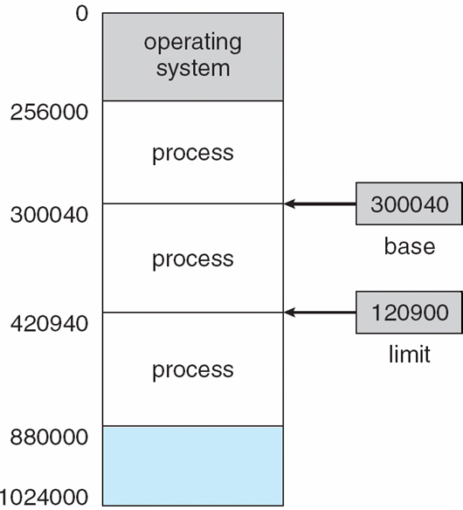
Base and Limit Registers
A pair of base and limit registers define the address space of a process
A process should be accessing and using that range.
Protection and Relocation can be
provided in this way.
also called Relocation Register
Each physical address should be in range [base, base+limit]

Slide 8
Logical vs. Physical Address Space
The concept of a logical address space that is bound to a separate physical address space is central to proper memory management
Logical address – generated by the CPU; also referred to as virtual address
Physical address – address seen by the memory unit

Slide 9
Logical and physical addresses
CPU
Main Memory (RAM)
base limit
60
56
52
48
44
40
36
32
28
24
20
16
12
08
04
00
24
28
int x
int y;
cmp ..
mov r1, M[28]
mov r2, M[24]
add r1, r2, r3
jmp 16
mov ..
PC
M[28+base]
IR
mov r1, M[28]
M[28+24]
M[52]
physical addresses
a relocatable program
28
24
20
16
12
08
04
00
int x
int y;
cmp ..
mov r1, M[28]
mov r2, M[24]
add r1, r2, r3
jmp 16
mov ..
logical addresses

Slide 10
Memory-Management Unit (MMU)
Hardware device that maps logical (virtual) to physical address
In MMU scheme, the value in the relocation register (i.e., base register) is added to every address generated by a user process at the time it is sent to memory
The user program deals with logical addresses; it never sees the real physical addresses

Slide 11
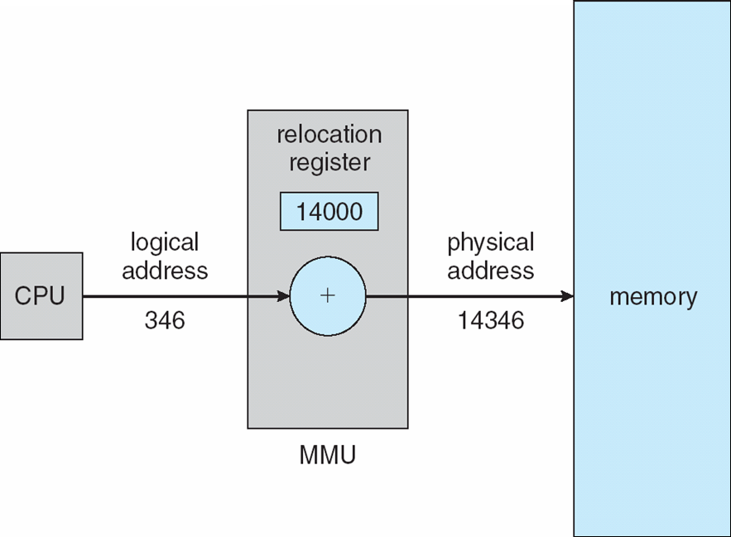
Dynamic relocation using a relocation register

Slide 12
Swapping
A process can be swapped temporarily out of memory to a backing store, and then brought back into memory for continued execution
Backing store – fast disk large enough to accommodate copies of all memory images for all users; must provide direct access to these memory images
Roll out, roll in – swapping variant used for priority-based scheduling algorithms; lower-priority process is swapped out so higher-priority process can be loaded and executed
Modified versions of swapping are found on many systems (i.e., UNIX, Linux, and Windows)
System maintains a ready queue of ready-to-run processes which have memory images on disk

Slide 13
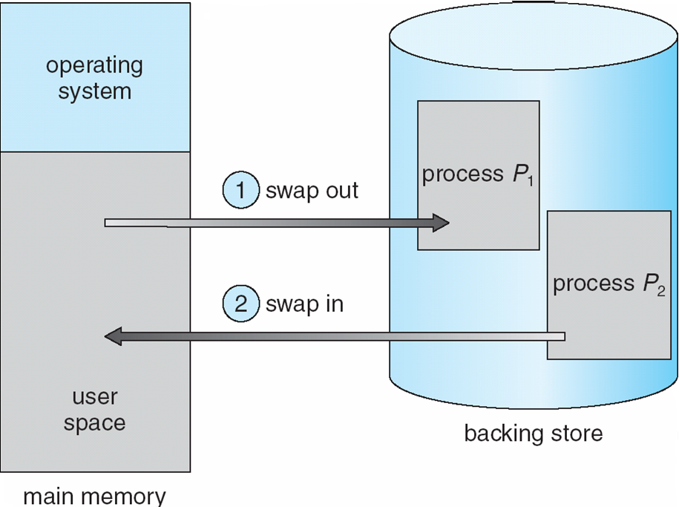
Schematic View of Swapping

Slide 14
Basic Memory Allocation Strategies
3 basic main memory allocation strategies to processes
1) Contiguous allocation
2) Paging
3) Segmentation

Slide 15
Contiguous Allocation
Main memory is partitioned usually into two partitions:
Resident operating system, usually held in low memory with interrupt vector
User processes then held in high memory
Relocation registers used to protect user processes from each other, and from changing operating-system code and data
Base register contains value of smallest physical address
Limit register contains range of logical addresses – each logical address must be less than the limit register
MMU maps logical addresses dynamically

Slide 16
Contiguous Allocation (Cont)
Multiple-partition allocation
Hole – block of available memory; holes of various size are scattered throughout memory
When a process arrives, it is allocated memory from a hole large enough to accommodate it
Operating system maintains information about: a) allocated partitions b) free partitions (hole)
OS
OS
OS
OS
process 5
process 5
process 5
process 5
process 9
process 9
process 8
process 10
process 2
process 2
process 2
process 2

Slide 17
Dynamic Storage-Allocation Problem
How to satisfy a request of size n from a list of free holes
First-fit: Allocate the first hole that is big enough
Best-fit: Allocate the smallest hole that is big enough; must search entire list, unless ordered by size
Produces the smallest leftover hole
Worst-fit: Allocate the largest hole; must also search entire list
Produces the largest leftover hole
First-fit and best-fit better than worst-fit in terms of speed and storage utilization

Slide 18
Dynamic Storage-Allocation Problem
Given five memory partitions of 100Kb, 500Kb, 200Kb, 300Kb, 600Kb (in order), how would the first-fit, best-fit, and worst-fit algorithms place processes of 212 Kb, 417 Kb, 112 Kb, and 426 Kb (in order)? Which algorithm makes the most efficient use of memory?
First-fit: 212K is put in 500K partition
417K is put in 600K partition
112K is put in 200K partition
426K must wait
Best-fit: 212K is put in 300K partition
417K is put in 500K partition
112K is put in 200K partition
426K is put in 600K partition
Worst-fit: 212K is put in 600K partition
417K is put in 500K partition
112K is put in 300K partition
426K must wait

Slide 19
Paging
Physical address space of a process can be noncontiguous; process is allocated physical memory whenever the latter is available
Physical address space will also be noncontiguous.
Divide physical memory into fixed-sized blocks called frames (size is power of 2, between 512 bytes and 8,192 bytes)
Divide logical memory into blocks of same size called pages
Keep track of all free frames
To run a program of size n pages, need to find n free frames and load program
Set up a page table to translate logical to physical addresses
Internal fragmentation

Slide 20
Paging
RAM (Physical Memory)
a program
0
0
1
a frame
(size = 2^{x})
1
2
2
logical address space
3
3
4
physical memory:
set of fixed sized
frames
4
5
5
7
program: set of pages
6
8
Page size = Frame size
9

Slide 21
Paging
RAM
a program
0
0
0
1
1
2
2
2
3
3
load
1
4
4
5
5
0 mapped_to 1
1 mapped_to 4
3
7
2 mapped_to 2
5
6
3 mapped_to 7
4 mapped_to 9
8
5 mapped_to 6
4
9
page table

Slide 22
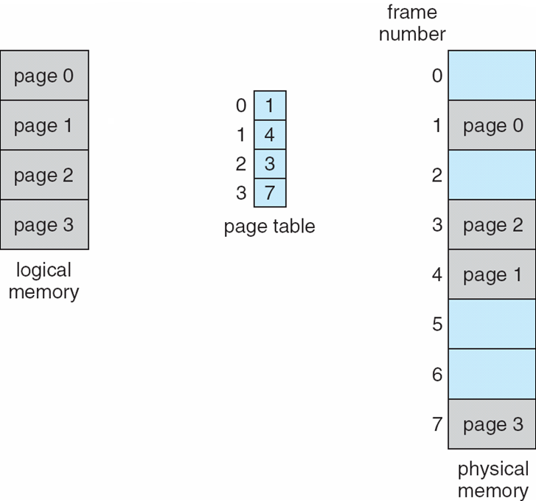
Example

Slide 23
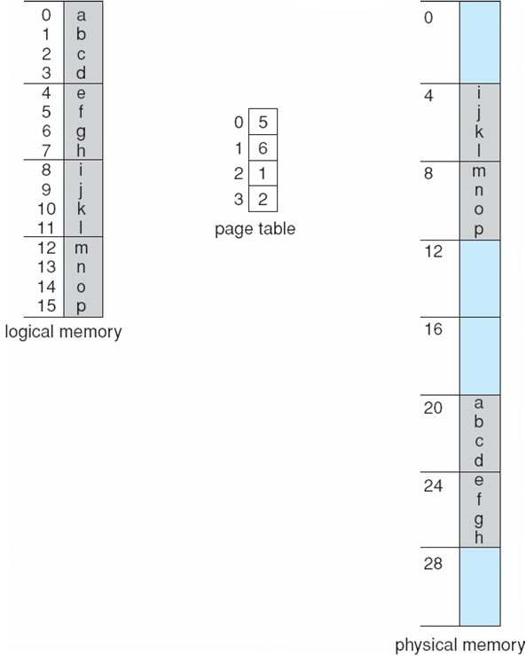
Paging Example
page size = 4 bytes
= 2²
LA = 5
PA = ?
5 is 0101
PA = 11001
4 bit logical address
LA = 11
PA = ?
32 byte memory
11 is 1011
PA = 00111
offset (dispacement)
inside page
page
number
LA = 13
PA = ?
13 is 1101
PA = 01001

Slide 24
Address translation example
m=3; 2³ ⁼ 8 logical addresses
2 bits for offset
0000
0001
0010
0011
0100
0101
0110
0111
1000
1001
1010
1011
1100
1101
1110
1111
n=2; page size = 2² = 4
frame 00
000
001
010
011
100
101
110
111
A
B
C
D
page 0
frame 01
E
F G H
1 bit for page#
page 1
E F G H
frame 10
Logical Memory
page table
A B C D
0
11
frame 11
1
10
each entry is used to map 4 addresses (page size addresses)
2 bits for frame#
Physical Memory

Slide 25
Address Translation Scheme
Assume Logical Addresses are m bits. Then logical address space is 2^{m} bytes.
Assume page size is 2^{n} bytes.
Logical Address generated by CPU is divided into:
Page number (p) – used as an index into a page table which contains base address of each page in physical memory
Page offset (d) – combined with base address to define the physical memory address that is sent to the memory unit
page number
page offset
p
d
(m – n) bits
n bits
m bits

Slide 26
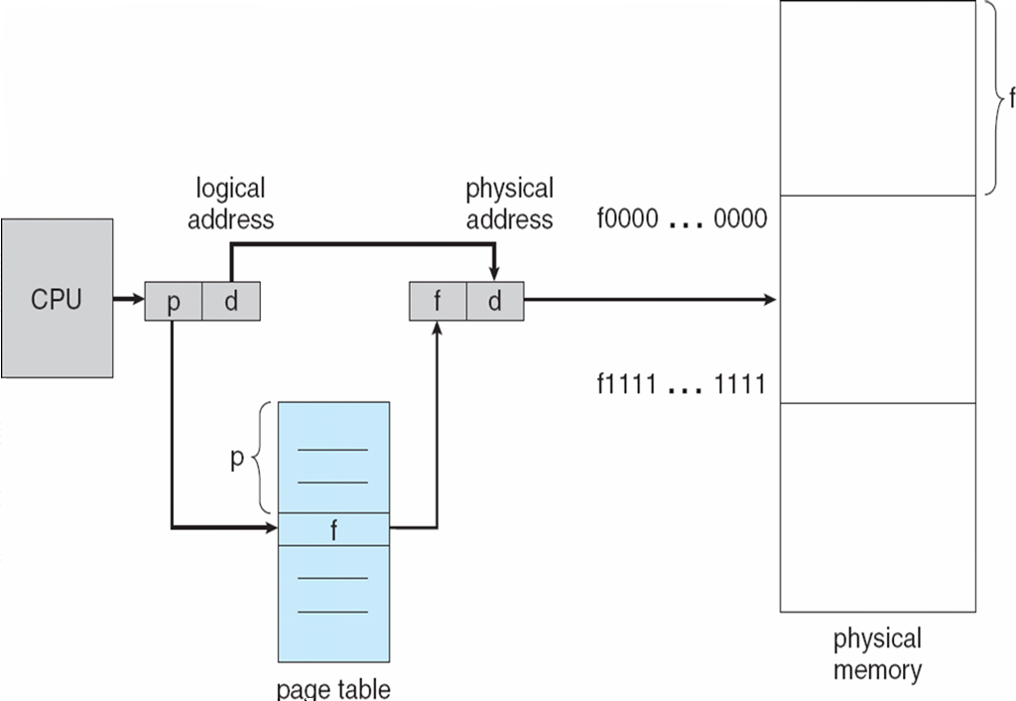
Paging Hardware: address translation

Slide 27
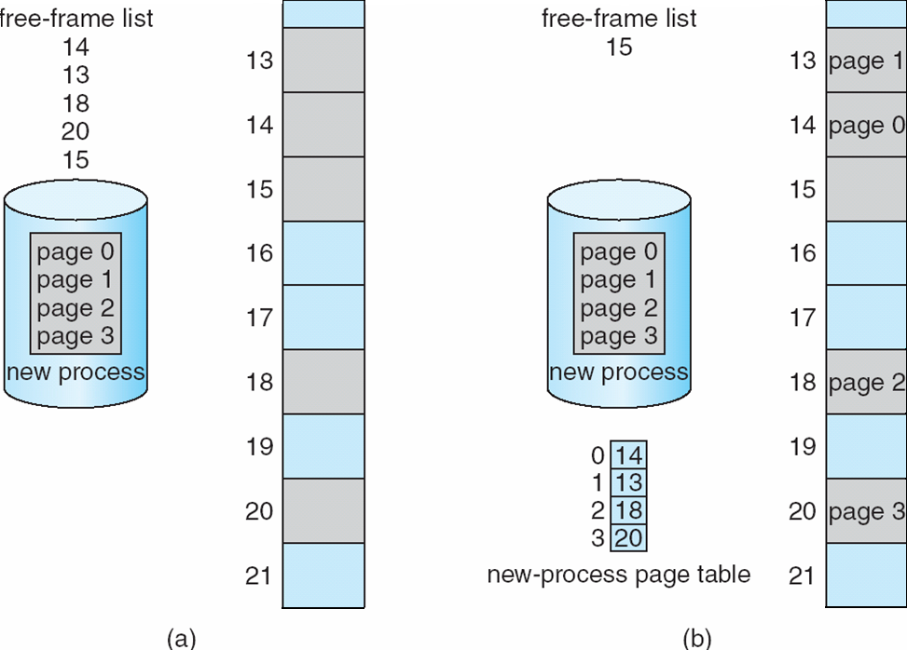
Free Frames
OS keeps info about the frames in its frame table
Before allocation
After allocation

Slide 28
Segmentation
Memory-management scheme that supports user view of memory
A program is a collection of segments
A segment is a logical unit such as:
main program
procedure
function
method
object
local variables, global variables
common block
stack
symbol table
arrays

Slide 29
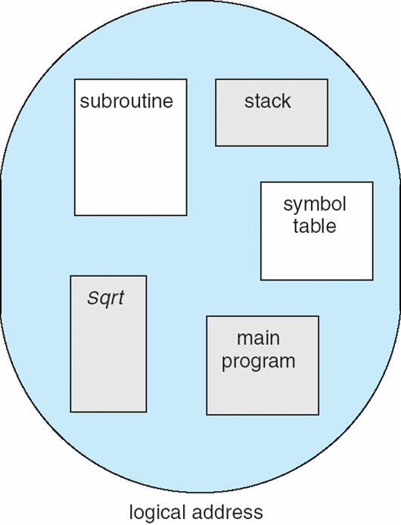
User’s View of a Program

Slide 30
Logical View of Segmentation
segment
1
1
4
2
3
4
2
3
user space
physical memory space

Slide 31
Segmentation Architecture
Logical address consists of a two tuple:
<segment-number, offset>
Segment table – maps two-dimensional logical addresses; each table entry has:
base – contains the starting physical address where the segments reside in memory
limit – specifies the length of the segment
Segment-table base register (STBR) points to the segment table’s location in memory
Segment-table length register (STLR) indicates number of segments used by a program;

Slide 32
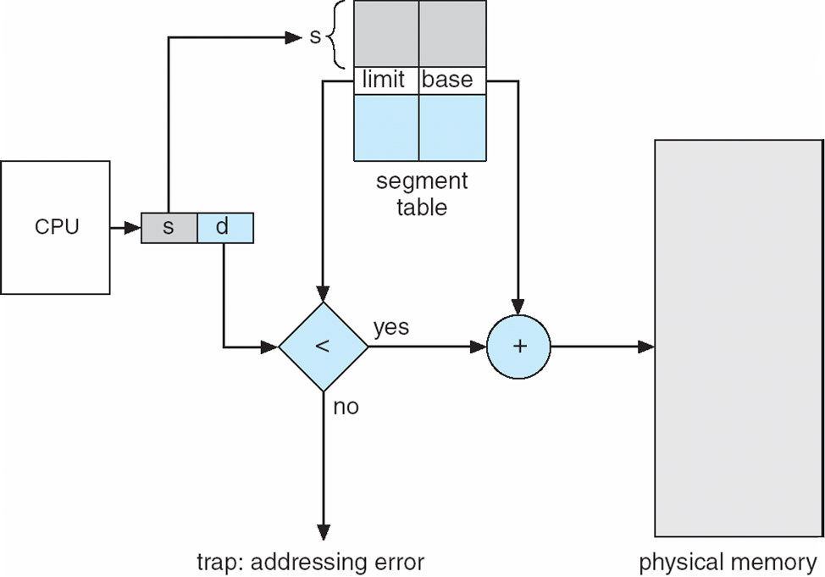
Segmentation Hardware

Slide 33
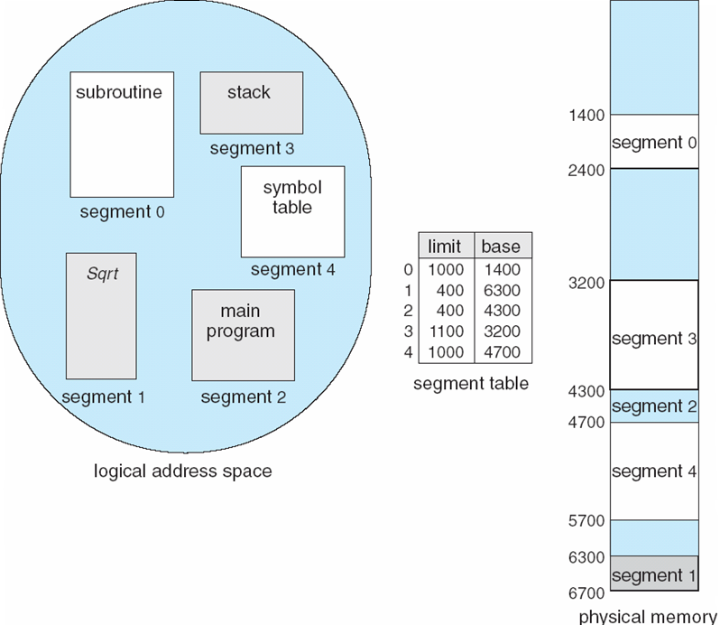
Example of Segmentation

